Slide 1
INDOOR POSITIONING SYSTEM USING DEEP LEARNING
Clyde Noronha
Mustafa Zaki
Shane Gracias
Ruman Mulla

Slide 2
Idea
Our project aims to provide the accurate, real-time indoor location of a user using deep learning, with the help of the accelerometer and gyroscope sensors available in smartphones.

Slide 3
Introduction
Global Positioning Systems (GPS) are limited to an accuracy of up to 5m, hence are not helpful indoors.
Indoor Positioning Systems (IPS) are a solution to locate oneself indoors.
Several approaches such as WLAN, Bluetooth, Geomagnetic Fingerprinting and Inertial Sensors.
Our approach is based on inertial sensors present in smartphones, using deep learning to improve the accuracy.
It is software based, and requires the user to just download an application and use it.
Significant applications include personal indoor navigation, healthcare monitoring and security.

Slide 4
Innovation
Makes use of a new solution (Deep Learning) to a very common problem (Indoor Positioning).
The deep learning model identifies patterns in the movement of the user along a trajectory and uses them to update the user’s position on the indoor map in real time.
This helps increase the accuracy as compared to previous solutions such as WLAN, Bluetooth and Fingerprinting, which are dependant on external hardware or the environment.

Slide 5
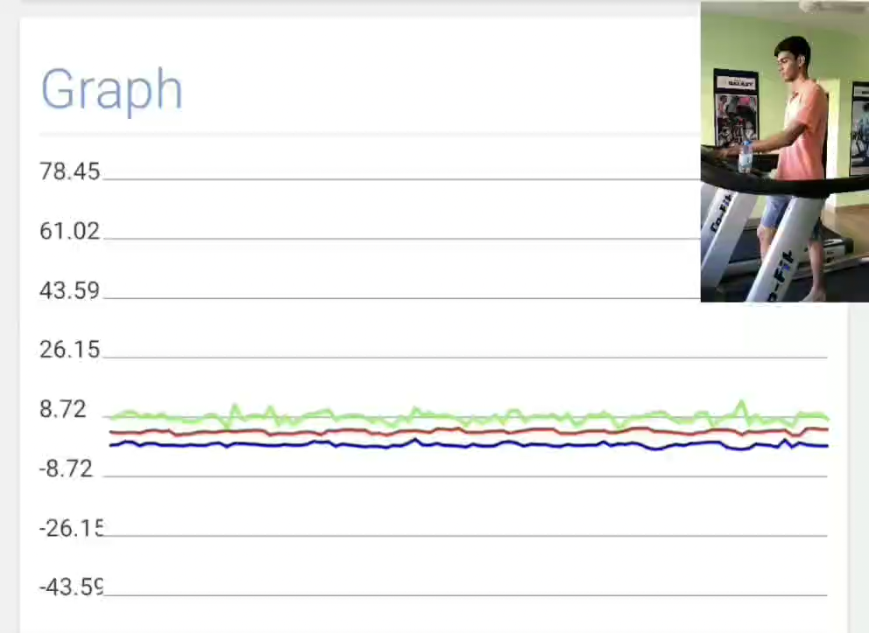
How it Works

Slide 6
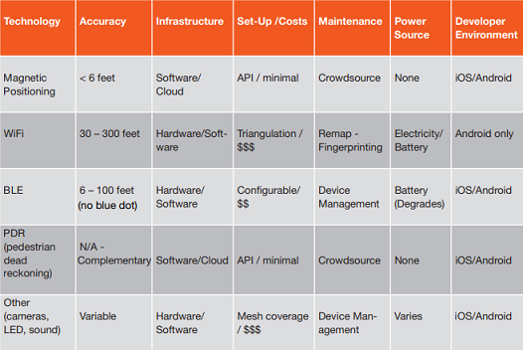
Comparison with other Technologies

Slide 7
Feasibility
We use inertial sensors in the smartphone (accelerometer and gyroscope) in order to position the user.
Since it incurs no hardware or maintenance costs, it is feasible to implement.
The number of smartphone users is increasing at a steady rate. Hence, anyone with a smartphone will be able to use the app without any further costs.
The accuracy of smatphone sensors is also increasing.

Slide 8
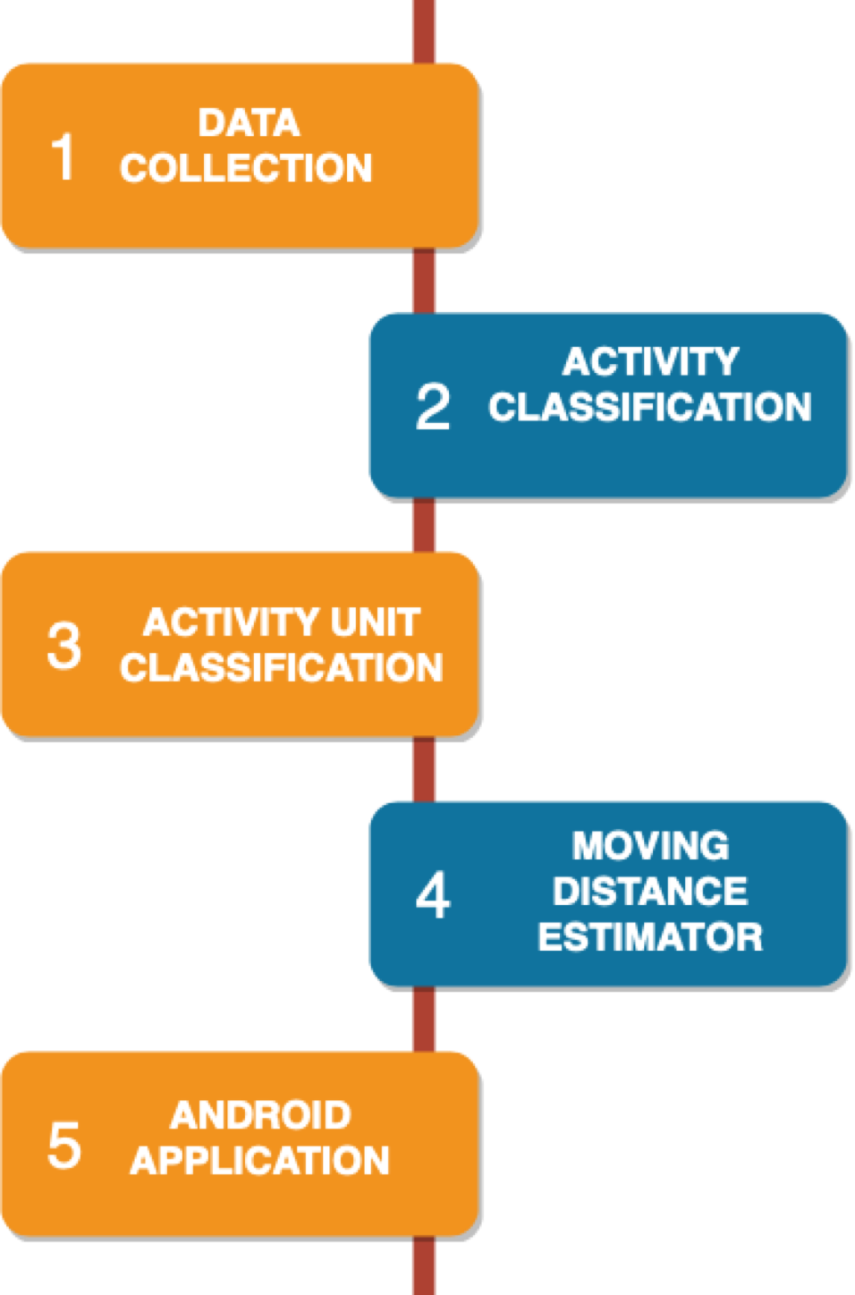
Design

Slide 9
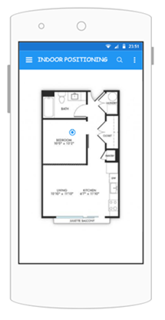
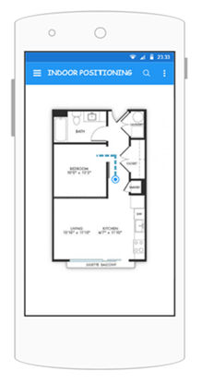
Final Mockup
User selects starting position
User moves and system updates position in real time

Slide 10
DEMO

